Slide 1
jQuery Matrix
Phillip Senn

Slide 2
Who is Phillip Senn?
Programmer since 1976
Applications Developer since 1982
ColdFusion Developer since 2003
Recent JavaScript Developer
Heard about JavaScript, but waited till jQuery became popular before diving in.

Slide 3
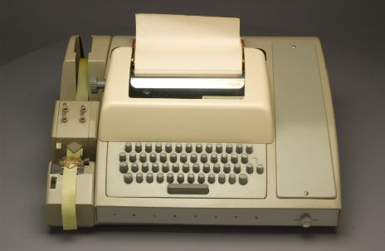
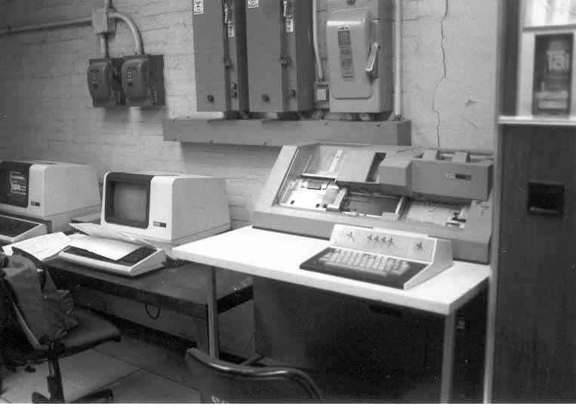
Before we start talking about js
Who here is an old school programmer?
8/1/2011 was “How I got into ColdFusion” day

Slide 4

Why JavaScript?
Implemented by all modern browsers
Runs client side, so it’s fast
The recommendation is to Learn JavaScript first and
then learn jQuery
That’s good advice.
But as you’re learning JavaScript
you need to be aware of
the issues that jQuery solves.

Slide 5

Why jQuery?
element.innerText vs. element.textContent
Solved with: element.text()
addEventListener(‘click’) vs. attachEvent(‘onclick’)
Solved with: element.click()
Numerous other examples

Slide 6
Why a jQuery Matrix?
There are two, nay, three types of learning:
Google Learning This is where you are looking for a specific answer
Book Larnin’ This is where you are taken on an adventure by the author
StackOverflow learning This is where you ask a question and get an answer from a fellow human being

Slide 7
Why a jQuery matrix?
Comprehensive list of notes
Sortable
Filterable (ex: anything related to Ajax)
Simple examples (with obnoxious variable names)
Rating (Intro, Beginner, Intermediate, Advanced)
Advice (Use/ Don’t use ala Doug Crockford)

Slide 8

Why a matrix?
Because Star Wars was already taken!
Besides, it is a matrix.

Slide 9
What’s a Name/Value pair?
X=1;
X is the name
1 is the value

Slide 10
What’s an object?
An object is a set of name/value pairs*.
var X = {A:10, B:20};
Is the same as:
var X= {}; X.A = 10; X.B = 20;
Is the same as:
var X = {}; X[“A”] = 10; X[“B”] = 20;
Thumbs up when you’re comfortable with the concept of what an object is.
* When the value is not a simple value but a function, it’s called a method.

Slide 11
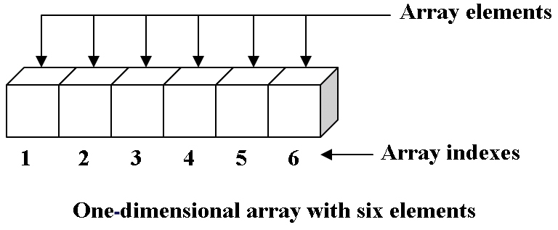
What is an array?
Old School Array:
To an old school programmer, an array is a consecutive block of memory addresses. But that’s not a JavaScript array.

Slide 12
A JavaScript Array is:
An object of number/value pairs
X[0] = 10;
X[200] = 20;
Is the same as:
X[“0”] = 10;
X[“200”] = 20;
And a few other properties:
X[“length”] === 201
Thumbs up?

Slide 13
JavaScript Array methods
pop
push
sort
reverse
splice
slice
concat
join
toString
Notes:
https://developer.mozilla.org/en/JavaScript/Reference/Global_Objects/array

Slide 14
What’s a jQuery object?
A jQuery object is also a set of number/value pairs.
The values are DOM elements*
X[0] === {paragraph element}
X[1] === {paragraph element}
X[“length”] === 2
With some extra properties:
X[“jquery”] === 1.6.2
X[“selector”] === ‘p’
* We’ll see what a DOM element is in the examples

Slide 15
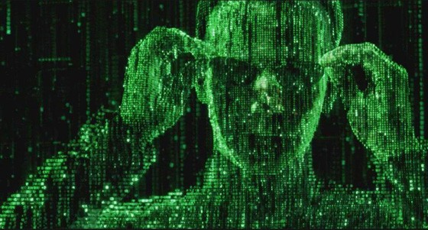
Are you ready to get jacked in?

